Slide 1
The Sámi people before and now Archives and indigenous peoples
Ellen Røsjø
Senior advisor
National Archives of Norway
Notes:
My name is Ellen Røsjø. I accept the welcome - on my own behalf; and I come in peace and friendship. I am from the land of the Sámi, another First Nations people.
(I work in the National Archives of Norway – in the department of appraisal and private archives and cooperate with the Sámi Archives.)
(I’m also engaged in archives and justice and everybody’s right to have a voice in the archives.)

Slide 2
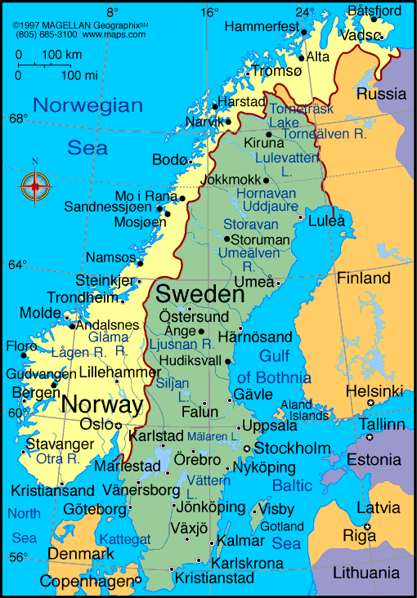
The Nordic countries
Notes:
First a map of the Nordic countries to show you where Norway is... Oslo, the capital is here, and Alta here...
It’s just as far from Oslo to the top of Norway as from Oslo to Rome in southern Europe.

Slide 3
Rock
Carvings
in Alta.
Dating 7000 to 2000 years back
Photo:
Ellen Røsjø
Notes:
This is a photo of Rock carvings in Alta in northern Norway – a Unesco world heritage site, it has more than 6000 carvings. They are between 7000 and 2000 years old. They are both Sámi art and Sámi archives at the same time. Alta has North-Europe’s largest concentration of rock art made by hunters and gatherers, and it’s Norway’s only prehistoric world heritage site. The red colour is done recently in order to bring forward the figures.

Slide 4
What is the talk about
The Sámi people before and now
Why developing archives is important for indigenous peoples
Sámi arkiiva (The Sámi Archives Norway)
The Future?
Photo: Sophus Tromholt 1882-83 Family with dog and reindeer outside lavvo
Notes:
What is this talk about?
The Sámi people before and now
Why developing archives are important for indigenous peoples
Sámi arkiiva (The Sámi Archives Norway)

Slide 5
Notes:
The Sámis are an indigenous people who have their traditional settlements in Norway, Sweden, Finland and Russia. The land that the Sámis traditionally inhabit is called Sápmi.
So: The Sámi people live in all the countries that have divided Sápmi between them, both inside and outside their traditional settlement area.
Today maybe there is a total of 80 to 100 000 Sámi people in all 4 countries, the majority lives in Norway.
Sapmi is one of the coldest places where people live.

Slide 6
1751 Lappekodicillen Boarder map 21 near Kautokeino drawn in 1765. National Archives Norway
Notes:
There were no borders in Sapmi before 1751. But Sapmi is and has been of central strategic and political importance, both because of its location, its natural resources and its ice-free ports. So the border with Sweden through the Sami areas was drawn in 1751, and the border with Russia was decided in 1826.
In an addition to the border treaty in 1751, the reindeer herding Sámis were granted certain special rights. This addition is called Lappekodicillen. Afterwards, this document has been interpreted as an important legal acceptance of Sámi rights, recognizing the Sámis as a separate group of people. The Lappekodicill still has relevance in the ongoing investigations on Sámi rights to land and water in the Sámi areas. Lapp is the colonial states’ word for Sámi.

Slide 7
The Sámi people before and now
Hunting, gathering and fishing
Siida-system
Colonization:
Nomadic herders with reindeer
Moving from mountain to the coast
Mountain Sámi & Sea Sámi
New national borders in other directions (north-south)
Photo: Sophus Tromholt 1882-83, Anna Aslaksdatter Gaup and Anna Jonsdatter Somby
Notes:
Originally the Sámis were hunters and gatherers. As you could see from the rock carvings. Archeological escavations also confirm this (and our oldest literary source, namely the Roman historian Tacitus’ description of fenni in Germania from 98 CE).
The old Sámi society was based on a so-called siida-system, where different hunting parties together would form a community. The siidas had a democratic governance where settlement was based on ecological adaptation and moving after the resources. Most siidas operated with several seasonal settlements, to be able to exploit the best natural resources in a location at all times. Reindeer move from inland to sea shore every year, according to the season. The family was the basic unit of Sámi society. Several families formed a siida together. As a rule, the families of a siida were related to each other.
The Sea Sámi lived and still live along the coast and the fjords, and they have traditionally had fishing and animal husbandry such as a cow or two and sheep for a living. The Sea Sámi were exposed to colonization and assimilation early on, already before the borders were imposed.
The Norwegian settlers first began to settle on the coast and gradually took over the traditional fishing grounds and habitats of the Sea Sámi. Some researchers believe that in earlier times there was Sea Sámi settlement south of Trøndelag,(pek på kart) and perhaps even further south. Sea Sámis also lived on the Kola Peninsula in Russia, and on both sides of the Gulf of Bothnia (pek på kart). Today, the centre of the Sea Sámi population is along the fjords and on the islands of Troms and Finnmark in Norway.

Slide 8
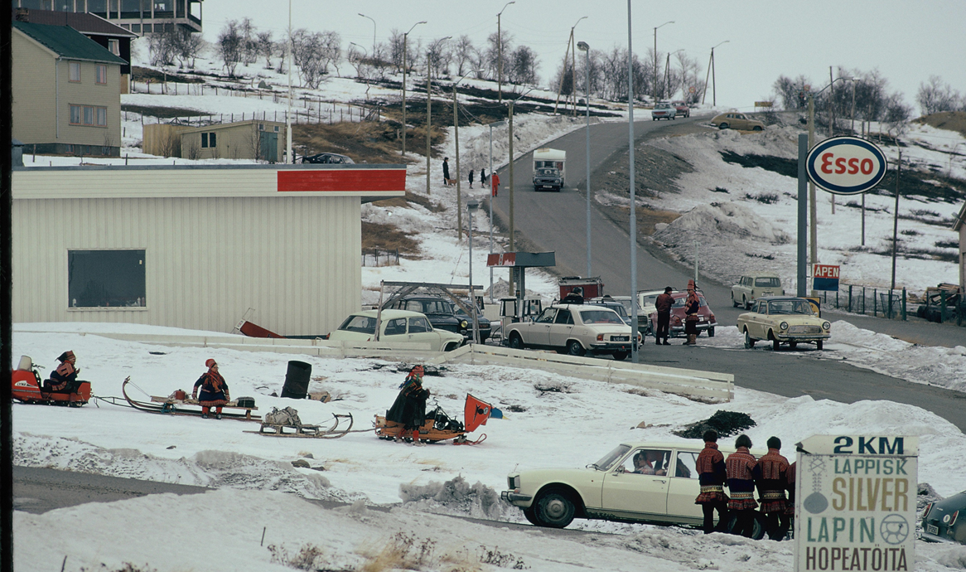
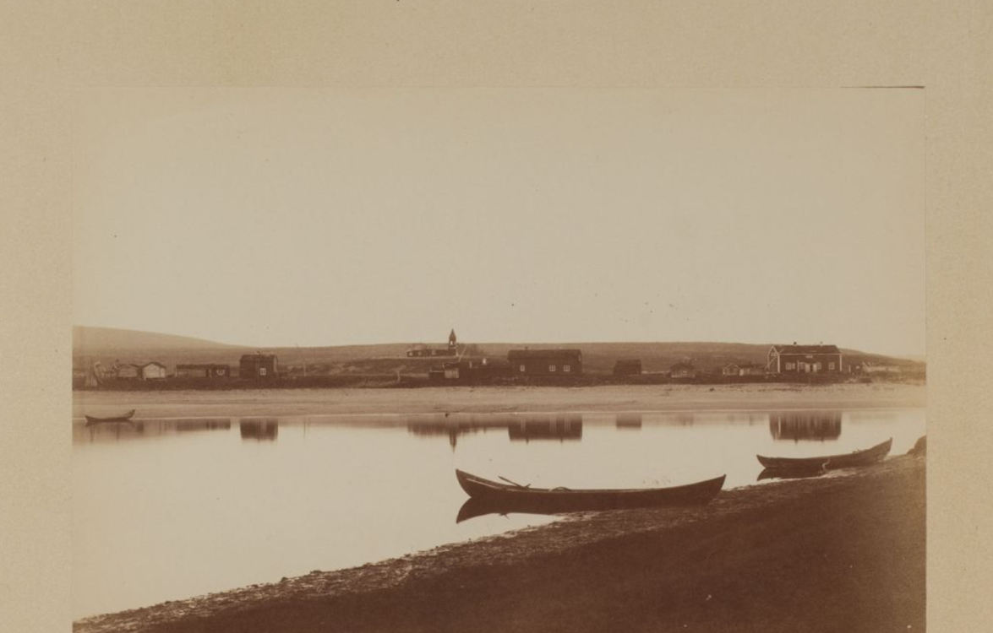
Guovdageaidnu / Kautokeino
Photo: Sophus Tromholt, Elisabeth Meijer, Erik Borg
Notes:
Here you can see three photos of Guovdageaidnu/Kautokeino (kartet foil 5)
To the left: A part of Kautokeino 1882-83 (Tromholt)
Sámi wedding at Easter early 20th century. Foto: Elisabeth Meyer. Finnmark fylkesbibliotek
Kautokeino at Easter in 1974. Beassášmárkanat Guovdageainnus/ Påske i Kautokeino. Vår 1974. Erik Borgs foto. Samisk arkiv
Kautokeino is referred to in the oldest written sources as a Sámi siida. But the Swedish state established that Kautokeino in 1674 must be a separate parish with a resident priest. A church was erected in 1701 and a courtroom in 1721, so state government institutions and public officials were put in place. But the society in Kautokeino in the first half of the 19th century was still a typical siida community.
Kautokeino is located in a border area that has been characterized by superpower politics. The village became Norwegian territory with the border treaty of 1751, and the reindeer herders there at that time, became Norwegian citizens. Before this, the village was administered from the Swedish side.

Slide 9
Sophus Tromholt 1882-83 On a trip to study the aurora borealis in Kautokeino River boat in Kautokeino. School children in Kautokeino
Notes:
Sophus Tromholt photographed Kautokeino in 1882-83.
He came to Bergen as a teacher and Northern Lights researcher, and in connection with the first international polar year he went to Kautokeino to study the Northern Lights. Today, Tromholt is best known for the great series of photos he took during his stay in Finnmark: landscapes, documentation of the research station, but primarily images of the northern population and their lives. Best known are his portraits of the Sámi population.
The photo collection is kept at the University Library in Bergen.
In 2013, UNESCO recognized the importance of Tromholt's photos for the world's cultural heritage when they included the collection on its Memory of the World list, making it one of the world's most important photo collections.

Slide 10
Sophus Tromholt 1882-83 In Kautokeino Sámi farm. Reindeer and pulks (sleighs)
Notes:
The reindeer belonged to individuals in the family. It was common for girls and boys to receive reindeer from parents and godparents when they were baptised. Personal reindeer marks were given and all reindeer with this mark and their offspring remained the individual's property. The same was true when women got married. In reindeer herding, women and men were equal partners.

Slide 11
Sophus Tromholt 1882-83 In Kautokeino Young Sámi girls. Young Sámi from Kautokeino
Notes:
The reindeer herding Sámis in Kautokeino had summer stays in coastal areas (peke på kart). On the coast, the larger winter siidas split into smaller summer siidas, most often in units that included the reindeer of the individual core family. The coastal areas had good grazing conditions and less insects that pester mammals than the Finnmarksvidda – the open mountain area/tundra during summer. The reindeer were allowed to walk freely until July. Then they started milking them again.

Slide 12
Sophus Tromholt 1882-83 In Kautokeino Lavvo. Brita Olsdatter Nango an child
Notes:
In August / September, the reindeer herds were moved back to the tundra, and the small siidas gathered again for a larger winter siida. The area around Kautokeino provided good grazing conditions for lav (a form of moss) in winter when there was little snow and no ice blanket formed under the snow. If the pasture conditions were difficult, the pine forest just over the border with Finland was an attractive winter pasture. The reindeer herders in Kautokeino could also take the reindeer through Finland and into Swedish territory, but they preferred the coniferous forests in Finland because it was a short distance to go there.

Slide 13
Livelyhood
Traditionally fishing, hunting, picking/harvesting, duodji and reindeer herding
Today more complex and differentiated as in any modern society
Parts of Sámi society keep up the traditional Sámi economy
Ealenjárgga siida suvdime/ Ealenjárga siida in »pramming». Spring 1974. Photo: Erik Borg, Samisk arkiv
Notes:
Traditionally, fishing, hunting, gathering, crafts and reindeer herding are central to the Sámi. Not so long ago, it was common to divide the Sámi people into four main groups by way of life and settlement: sea Sámi, river and lake Sami, forest Sámi and mountain Sámi, but today the Sámi community is as differentiated as any other modern society. However, parts of the Sámi population maintain the traditional forms of livelihood, and in Sámi politics many are concerned with how to continue traditional Sámi economy in modern society.

Slide 14
Duodji
Notes:
Traditional Sámi crafts, duodji, clearly shows how much weight Sámi community has always put on beauty. Common consumer goods and everyday objects have been embellished and richly ornamented. The use value has always been the most important, but the requirement was that the product should also be beautiful to the eye. Duodji training was formerly part of the upbringing, and in older written sources, crafts are constantly mentioned as a Sámi speciality.
Duodji production is still an important part of many Sámis’ income. The state provides direct support to duodji, through artisan organizations and the Sámi business fund, managed by the Sámi Parliament.

Slide 15
Joik
Mari Boine
Notes:
A joik (or vuelie) is a traditional form of song of the Sámi people of the Nordic countries and Kola Peninsula of Russia.
As an art form, each joik is meant to reflect or evoke a person, animal, or place.
Joik has had a renaissance since the 1970s as a source of inspiration for modern musicians in a whole range of genres. Well-known artists of joik are Mari Boine, and Frode Fjellheim.

Slide 16
Riddu Riđđu – the indigenous festival in Kåfjord
Photo: Riddu Riđđu
Notes:
There is an active Sámi music scene, which is reflected in the many festivals that are held in different places in Sápmi. Most famous is the indigenous festival Riddu Riđđu in Kåfjord in Nord-Troms, which is held every summer in July with artists from a number of indigenous peoples around the world. The festival has grown to become the most important meeting place for modern indigenous music today. Also Aboriginal people from Australia have participated. And maybe people from here could have contact with this festival?

Slide 17
Representation
The Norwegian constitution from 1814 excluded Sámi from political participation. I 1821 it was changed, and privileged men, including some Sámi in Finnmark got the right to vote
But it took a long time to get representation in Parliament. In 1906 (-1912) the first known Sámi delegate was elected, Isak Mikel Saba
After Saba the labour movement had no Sámi representative until after the war
Isak Mikel Saba. Photo: Stortinget
Notes:
The Norwegian constitution from 1814 was not democratic. For example, only privileged men had the right to vote. It also excluded Sámis from political participation. In 1821 it was changed so that privileged male Sámis and other privileged men in Finnmark got the right to vote. General suffrage for all adults was completed in 1919.
But it took a long time to get representation in Parliament. In 1906 the first known Sámi delegate was elected, Isak Mikel Saba - through a coalition of the socialist and the Sámi movement. He sat until 1912.
But after Saba the labour movement had no Sámi representative in parliament until after 1945.

Slide 18
The Kautokeino Rebellion 1852
The rebels killed the sherrif and the merchant and knocked down the priest and others
The rebels came from the same siida in Kautokeino, about 50 in total
Harsh punishment 1853:
17 women and 11 men were sentenced, and two of the rebels were beheaded.
Confiscation of reindeer, taking the deer from children and wives
Longterm consequences
The border between Norway-Sweden and Finland-Russia closed for all moving of reindeer 1852
Lars Jacobsen Hætta (1834-1896) eller Jáhkoš-Lásse in Kautokeino in 1882/1883. Photo: Sophus Tromholt
Notes:
Inspired by the Swedish preacher Læstadius, the Sámis in Kautokeino in 1851 established their own trading and religious activities and stopped using the church and trading post imposed by the Norwegian state. For the merchant in Kautokeino and the priest, this meant a low turnover and empty churches. Some even disturbed the priest during church service in Kautokeino and Skjervøy. The unrest increased in 1851/52. The priest, who was the supreme authority on the spot, responded by arresting the leaders of the rebels. This paralyzed the very basis of existence for the Sami: Without the men, affected families were unable to care for the reindeer from which they lived. The trial that ended sentencing longer prison terms for some and the payment of court costs caused the Sámis to revolt against the authorities. They killed the sheriff and the merchant and beat up the priest and others. In the trial afterwards, seventeen women and eleven men were sentenced, and two of the rebels were beheaded.
Reindeer were confiscated and sold at auction in the spring of 1853 to cover the costs of custody and litigation in Alta. State representatives counted a family's reindeer regardless of who in the family owned it, so that even children and spouse's specially owned reindeer were counted when reindeer were brought in for auction. This not only affected the family in the moment, but it also weakened the children's foundation for their own reindeer herd in the future and made it difficult to maintain their social position.
Negotiations between Norway-Sweden and Finland-Russia culminated in the closure of the border with Finland on September 15, 1852 for all relocation of reindeer. For the reindeer herding families that were used to operating in a landscape without borders, this became a major obstacle in the practice of reindeer herding.
This event has also been made into a film called the Kautokeino Rebellion in 2008 directed by Nils Gaup – it is worth watching. On the photo: One of the rebels. He later translated the Old Testament to sámi! He was fluent in Sámi, Norwegian and Finnish.

Slide 19
Sámi language map
Notes:
There are traditionally eleven Sami languages, now ten languages are left: Northern Sámi is the largest Sámi language. These languages belong to the Finnish-Ugric branch of the oral languages. Several of the Sami languages are very different from one another. The vast majority of Sami also speak the national language in the state in which they live, and some Sami are more familiar with this language, ie Norwegian, Swedish, Finnish or Russian, than with Sámi.
From the mid-1800s, the Norwegian state carried out an active assimilation policy towards the Sami, which meant that the language disappeared from large areas of Sápmi. Although there has been a Sami revitalization of culture, identity and language since the second half of the 20th century, the Sami languages are still threatened. Urbanization of Sami also poses new challenges for the maintenance of the Sami languages.
With the Language Act, Sami is recognized as an official language in Norway (1987). Sami languages have special rights within the Sami language management area (1992).
Between 20,000 and 30,000 Samis are registered to speak the different Sami languages. One expects that there are about 80 to 100,000 Sami, and of these, about 30% can speak a Sami language, and about 15 % use a Sami written language. The most commonly used Sami languages today are Northern Sami, Lule Sami and Southern Sami. Internationally, the Sami languages are characterized as endangered, seriously threatened or almost extinct.

Slide 20
Norwegianization – assimilation politics
End 1800s: School laws – all education in Norwegian
Till after WW ll
Crisis in Sámi economy as agriculture and fisheries recquired more capital
Gave basis for a downgrading of the Sámi culture
Mass immigration of Kven – gave way to security arguments for the assimilation policy
The priest Mads Le Maire visiting Strand boarding school and school chapel, 1905. Photo: Ellisif Wessel
Notes:
From the mid-1800s, a line was introduced in cultural policy towards the Sami with an increasingly clear profile of assimilation (Norwegianization). The school laws from the end of the 19th century stipulated that all teaching should take place in Norwegian. Teachers had to report, and a system of awarding was almost developed for the teachers who were able to assimilate the most. This policy remained firm until after World War II. The children mostly attended boarding schools far away from home and could start school without knowing a word of Norwegian.
Modernisation of fishing and agriculture required capital that most Sámis did not have, and this lead to a crisis in the Sámi economy in several areas.
This also provided the basis for a downgrading of the Sami culture.
Mass immigration of Kven from Finland, which at that time was subjected under Russia – also gave impetus for security arguments for the assimilation policy. “The Peril from the East!”

Slide 21
Elsa Laula Renberg Brurskanken Samiske Kvindeforening (1910)
Notes:
In the southern Sami area, Elsa Laula (later Elsa Laula Renberg) worked diligently on both sides of the Norwegian-Swedish border to organize the Sámi. She was the leader of one of the first joint Sami organisations in the Nordic countries in 1904.
Elsa Laula Renberg grew up with parents who did reindeer herding I
n the border regions between Norway and Sweden. She was one of the few Sami women in her generation who had higher education.
In 1904, the world's first joint association, Lapparnas Centralförening, was founded in Stockholm with Elsa Laula Renberg as leader. At the same time, she published the pamphlet Inför lif eller död / In life or death which addressed the Samis’ right to land, water and schooling. In 1905, she got an audience with the king to speak for the Sami cause. After moving to the Norwegian side of the border, Elsa Laula Renberg joined the founding of a regional Sami association in Helgeland (peke på kartet) in 1907 and founded in 1910 the local Brurskankens Sami women's association (on the photo to the left). To the right is Elsa with her husband and two children.

Slide 22
Organising
The first International Sámi General Meeting 1917 in Trondheim/Tráante
February 6, is now celebrated as the Sami Day
Photo: Hilfling-Rasmussen. NTNU UB
Notes:
Elsa Laula Renberg and the Brurskanken Sami Women's Association initiated the large international Sami General Meeting held in Trondheim/Tráante in 1917. Elsa was one of the most central personalities at the meeting. The meeting's opening date, February 6, is now celebrated as the Sami Day in Norway, Sweden, Finland and Russia. Elsa Laula Renberg died of tuberculosis in 1931, only 53 years old. Her birthday is a Sámi flag day.

Slide 23
Organising
1948 Norske Reindriftsamers Landsforbund
1956 the Nordic Sami Council
1992 the Sámi Council – with Russia
NGO status within the UN system
Ealenjárgga siida ráhkaneame johttát./ Ealenjárga siida preparing the springmoving. 1973. Erik Borg’s photo. Samisk arkiv
Notes:
In 1948, the reindeer herders established the Norske Reindriftsamers Landsforbund (NRL) as a professional organisation for reindeer herders.
The Sami Council was established in 1956 as the "Nordic Sami Council". This is an umbrella organisation for Sami civil society organisations in different countries. In 1992, a Russian joint organisation joined the Sami Council for the first time, thus removing the word "Nordic" from the name. The Sami Council has its secretariat in Utsjoki, Finland, and its highest body is the Sami conferences; general meetings are held regularly with representation from all member organisations.
The Sámi Council has official status (NGO status) within the UN system and has participated very actively in the work of designing an Indigenous Declaration in the UN Working Group on Indigenous Peoples in Geneva.

Slide 24
The Alta Case 1968-82 Hunger strikes by the Parliament 1979, 1981
Photo: Kim Hart, Scanpix
Notes:
The development of the Alta - Kautokeino water systems is the most contentious development of hydropower in Norwegian history.
The Alta case was a political conflict that lasted from 1968 to 1982. The conflict started with opposition from local people and conservationists, but it ended up being a matter of indigenous rights. Both in 1979 and 1981, the Sami staged vigorous protests against the development, and both times hunger strikes were used. The picture shows, among other things, Mikkel Eira as a hunger striker in front of the Norwegian Parliament in 1981.

Slide 25
Growing support
Notes:
In addition to affecting reindeer herding: The village of Maze/ Masi not far from Kautokeino was going to be submerged, and probably the salmon in the river would be affected also.
There were demonstrations all over the country. Thousands of people took part in civil disobedience actions to prevent the construction work. When the conflict peaked in 1981, the Norwegian authorities sent 600 police officers to Alta. In 1982, the Supreme Court agreed with the District Court that the development was legal. The same year, the People's Action Committee was dissolved.

Slide 26
Occupation PM’s office The new dam. The village Máze saved
Photo: Foto: Erik Thorberg / SCANPIX. 08.02.1981.
Kai Erik Bull, NRK
Notes:
Despite the support and the 14 Sámi women’s Occupation of the Prime Minister’s office, the new dam was built.
Even though the fight against the dam was lost, the struggle led to an upsurge in the fight for Sami rights. It was not just a victory that the village of Maze/Masi was saved from the river's embankment. The Samis and Sami culture also reached their heyday during the actions.

Slide 27
As a result
Process from national monoculture to diversity, from 1980’s onwards
Sámediggi. The Norwegian Sámi Parliament – 1989
Sámediggi in Sweden in 1992
Sámediggi in Finland 1996
a Sámidelegation 1971 - one of the inspirations for the Sámediggi
Photo: Sámediggi
Notes:
As a result of the actions the following was achieved:
A Process from national monoculture to diversity was started, from 1980’s onwards.
We got The Sámediggi. The Norwegian Sámi Parliament – in 1989 (after a law governing the Sámis passed in 1987 in the Norwegian Parliament on having a Sámediggi and other Sámi law questions like Sámi and Norwegian languages are given equivilency and that the Samediggi can decide use of the Sámi flag)
The Sámediggi in Sweden came in 1992 and
The Sámediggi in Finland in 1996
Finland had got a Sámi delegation in 1971- one of the inspirations for the Sámediggi
Russia does not have a Sámi parliament and has, since Putin, closed off all communication between the Samis there and the rest. Samis have also been deported from their traditional area (Murmansk) to other parts of Russia.

Slide 28
The Sámediggi’s plenary 2017-2021
Ordinary parties
Unique Sámi parties
Photo: Sámediggi
Notes:
There are ordinary parties and unique Sámi parties represented.
The Sami parliaments do not have full powers. For example, they cannot legislate on taxation or make laws. They have an advisory function towards the respective nation states. The Norwegian Sámediggi has 39 representatives from 7 constituencies..
There is also a Sami parliamentary council that gathers the Sámediggis in Sápmi.
I Norge er Sametingets arbeidsområde alle saker som etter tingets oppfatning berører den samiske folkegruppa. Tinget forvalter dessuten en del ansvarsområder delegert fra staten, og det konsulteres av myndighetene i flere saker. Det avholdes valg til sametingene hvert fjerde år. I Norge sammenfaller dette med stortingsvalg og fylkestingsvalg. Alle som ønsker å stemme eller stille til valg ved et sametingsvalg, må være registrert i sametingets valgmanntall i staten de bor i.
Du kan melde deg inn i sametingets valgmanntall ved å skrive under på at du oppfatter deg som same, og at du oppfyller visse krav. Disse kravene er ulike fra land til land, men har å gjøre med blant annet ens eget eller forfedrenes språk, eller hvorvidt ens forfedre har vært registrert som samer i visse offentlige dokumenter.
I Norge er kravene at man (a) selv oppfatter seg som same, og at (b1) en selv, eller minst én av ens besteforeldre eller oldeforeldre har hatt samisk som hjemmespråk under oppveksten, eller (b2) at minst én av ens foreldre står eller har stått i valgmanntallet.
I 2017 var 16 958 personer innmeldt i Sametingets valgmanntall i Norge. Maybe a total of 100 000 Sámi people in all 4 countries, the majority lives in Norway.

Slide 29
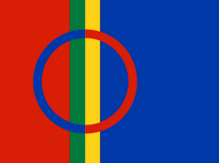
The Norwegian Constitution § 108
It is the responsibility of the state authorities to make arrangements for the Sámi people to secure and develop their language, their culture and their social life.
Adopted in 1988 (§110 a). The provision marks an end to earlier assimilation policies.
Based on the UN International Covenant on Civil and Political Rights article 27
Notes:
The Norwegian Constitution § 108 (got a provision in 1988)
It is the responsibility of the state authorities to make arrangements for the Sámi people to secure and develop their language, their culture and their social life.
The provision marks an end to earlier assimilation policies.
It is based on the UN International Covenant on Civil and Political Rights article 27.
The Sami flag that you can see here, was adopted by the Sami conference in Åre, Sweden in 1986. A list of official Sami flag days for both Norway, Sweden and Finland has been prepared. The flag is also in use in Russia

Slide 30
Nordic Sámi Convention, 2017
The states shall take into account Sámi cultural heritage, Sámi cultural expression and Sámi traditional knowledge when making decisions on issues concerning Sámi conditions.
Sámi material cultural heritage shall be protected by law. The states will work to ensure that the Sámi intangible cultural heritage is safeguarded. The Sámi Parliament or authorities in collaboration with the Sámi Parliament, Sámi museums or other Sámi institutions shall be responsible for matters concerning Sámi cultural heritage.
Sámi cultural heritage held by the state or other public body shall be managed by the Sámi Parliament or by museums or institutions in cooperation with the Sámi Parliament.
States shall work to ensure that Sámi cultural property is repatriated and managed in accordance with the third paragraph.
Photo: Sophus Tromholt. Sámi married couple.
Notes:
The Nordic Sámi Convention of 2017 says
The states shall take into account Sámi cultural heritage, Sámi cultural expression and Sámi traditional knowledge when making decisions on issues concerning Sámi conditions.
Sami material cultural heritage shall be protected by law. The states will work to ensure that the Sami intangible cultural heritage is safeguarded. The Sámi Parliament or authorities in collaboration with the Sámi Parliament, Sámi museums or other Sámi institutions shall be responsible for matters concerning Sámi cultural heritage.
Sami cultural heritage held by the state or other public body shall be managed by the Sami Parliament or by museums or institutions in cooperation with the Sami Parliament.
States shall work to ensure that Sami cultural property is repatriated and managed in accordance with the third paragraph.

Slide 31
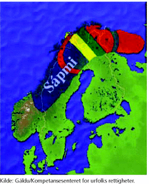
The Sámi people and archives
… live over 4 nation states
… have not been an actor in traditional western recordkeeping and archives
… others have archived and collected material on them… – colonial perspective
A negative situation with archives spread in many countries, uncoordinated and with little indigenous control
Sápmi
Notes:
The Sámi people and archives
… live across 4 nation states
… have not been an actor in traditional western recordkeeping and archives
… others have archived and collected material on them… – with a colonial perspective
This has created a negative situation with archives spread in many countries, uncoordinated and with little indigenous control
When it comes to archives:
Extraordinarily little has been written down of the Sámis’ own important events

Slide 32
«Quod non est in actis, non est in mundo» (If you’re not in the archives, you don’t exist)
Archives are unique
The archive is a selective memory
Automatic preservation of all public archives (by law)
Private archives are rather randomly preserved
Other forms of archiving not recognized (oral and practical transfer of knowledge)
Result:
Indigenous people don’t / seldom have a voice of their own in archives
A distorted societal memory
Important to collect private archives to get more voices into the archives
Bordime snowmobilai biergasiid ja ráhkkaneame mátkái duoddara badjel/ Packing a snowmobil in Máze for a trip over vidda/the tundra. Erik Borg’s photo. Samisk arkiv
Notes:
A roman saying says «Quod non est in actis, non est in mundo» (If you’re not in the archives, you don’t exist) – this affects indigenous and oppressed people – if you destroy archives you take away rights.
A few facts about traditional archives in the western world:
Archives are unique – unlike published material, there is only one original
The archive is a selective memory – made to fulfill the specific needs of an agency a s o, it is not democratic
We have automatic preservation of all public archives (by law) - while
Private archives from organisations, companies, indigenous groups and individuals are randomly preserved.
Other forms of archiving have not been recognized - like
Sámi society's heritage has been based on oral and practical transfer of knowledge
Result:
indigenous people don’t /or very seldom have a voice of their own in traditional archives.
Because of this, we get a distorted societal memory – It is therefore important to collect private archives to get more voices into the archives reflecting all the people in a country over time. That’s what people understood when the Sámi arkiiva was started up.

Slide 33
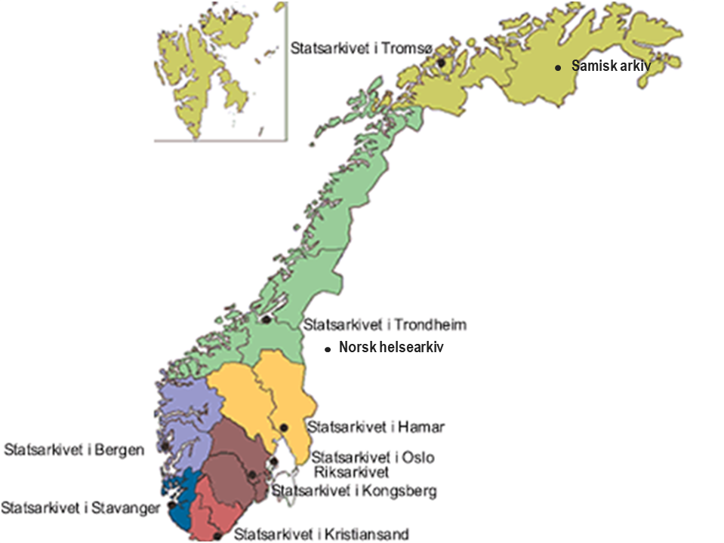
Sámi arkiiva and Guovdageaidnu / Kautokeino Sámi arkiiva is situated in the new building Diehtosiida, with the Sámi University College
Photo: Ellen Røsjø
Notes:
Sámi arkiiva/The Sami archives is situated in the new building Diehtosiida in Guovdageaidnu/Kautokeino , with the Sámi University College
The map – shows the location

Slide 34
Sámi arkiiva
Based in Guovdageaidnu, has a national Sámi scope
Founded 1995 based on the needs of researchers (Nordic Sámi Institute) and civil society
Cross-border activities upcoming – the Sámi area in Norway, Finland and Sweden
Runebomme. Ringve museum
Notes:
Sámi arkiiva Norway (1995-) - is from 2007 part of the National Archives of Norway
The archive is based in Guovdageaidnu, but has a national Sámi scope.
The archive was founded based on the needs of researchers (Nordic Sámi Institute) and Sámi civil society
The rune drum on the photo: Originally, the noide (shaman) used the rune drum when he wanted to attain a trance. The drum was used by most Arctic people. The drum can be considered as an archive.
By asking the Sami about the significance of the rune-drum figures, Thomas von Westen later acquired basic knowledge of the ancient religion of the Sami.
At the same time, Christian missionaries sought to destroy these instruments. A large number of drums were confiscated by Sámi missionaries and other officials as a part of an intensified Christian mission towards the Sámi during the 18th century. Other drums were bought by collectors. Between 70 and 80 drums are preserved; the largest collection of drums is now at the Nordic Museum, in Stockholm.

Slide 35
Sámi arkiiva
The Sami archives collects, preserves and makes available archival material from the Sámi community
The purpose of this is to:
Ensure a written historical source material that could shed light on Sámi history and
Making this available to the public
This is an important basis for work on Sámi language, history and culture
Sophus Tromholt: Sámi boys skiing
Notes:
The Sámi archiiva collects, preserves and makes available archival material from the Sami community.
The purpose of this is to:
ensure a written historical source material that could shed light on Sami history and
making this available to the public.
This is an important basis for work on Sami language, history and culture.

Slide 36
Sámi arkiiva
Holds private archives of individuals, politicians, researchers, organisations, associations for rein pasture and slaughtering, fishing and other companies
Also holds public records of importance to the Sámi society, history and culture. Sámediggi (The Sámi Parliament), Beaivvaš (Sámi Theatre), Gáldu (resource centre for the rights of indigenous peoples)
Ealenjárgga siida suvdime/ Ealenjárga siida in «pramming» 1974. Erik Borg’s foto, Samisk arkiv
Notes:
Sámi arkiiva
Holds private archives of individuals, politicians, researchers, organizations, associations for reindeer pasture and slaughtering, fishing and other companies.
also holds public records of importance to the Sami society, history and culture. Sámediggi (The Sámi Parliament), Beaivvaš (Sami Theatre), Gáldu (resource centre for the rights of indigenous peoples)

Slide 37
Sámi arkiiva: Vocal (oral) archives - Sámi society's heritage is based on oral and practical transfer of knowledge
Recordings of interviews and joik from all over Sápmi – the Sámi area:
Ruong, Frette and Jernsletten’s collection of sami languages 1956-1978
Nordic Sámi Institute’s vocal archives, 1974-2005
Recordings of storytelling in South Sámi language
Girkobassi Šuoššjávrri kapellas/
Church Sunday in Šuoššjávri chapel.
Spring 1974. Erik Borg’s photo, Samisk arkiv
Notes:
Sámi arkiiva also holds Vocal (oral) archives – Sami society's heritage is based on oral and practical transfer of knowledge
Recordings of interviews and joik (vis til slutt) from all over Sápmi – the Sami area:
Ruong, Frette and Jernsletten’s collection of sami languages 1956-1978
Nordic Sami institute’s vocal archives, 1974-2005
Recordings of storytelling in south sami language: https://www.arkivverket.no/om-oss/samisk-arkiv/traante-2017 (ikke vis)
A joik, or vuelie, is a traditional form of song of the Sami people of the Nordic countries and Kola Peninsula of Russia. As an art form, each joik is meant to reflect or evoke a person, animal, or place.
The sound of joik is comparable to the traditional chanting of some American indigenous cultures.^{[1]} There are also features shared with the shamanistic cultures of Siberia, which mimic the sounds of nature.
Ex. Joik – here is former president of the Sami parliament Ole Henrik Maggas joik to the Tibetan people – https://media.digitalarkivet.no/play/105104/2 (ligger på maskina)

Slide 38
The Future?
Čakčanjuovvamat/ after the autumn slaughtering. Autumn 1973. Erik Borg’s photo. Samisk arkiv.
Notes:
So what about the Future for the Sámi people?
The Sámis have achieved a lot when it comes to representation and rights.
Today there are big development projects threatening the areas where the reindeer are grazing. Whether it be petroleum, wind power, mining or hydro power development, tourism or agriculture. All of these are expanding all the time. More than 30 % of the reindeer grazing land has now disappeared.
So: to maintain traditional reindeer herding is becoming more and more difficult. A reindeer herder recently took his case to the European Court of human rights because the Norwegian legal system said he must reduce his reindeer from 116 to 75. This was in the High Court after decisions in Jovvset Ante Saras (25) favour in two lower parts of the judicial system. The decision said that to reduce the effects (strain?) on the grazing land all reindeer owners have to do this, even the smallest ones. (At the same time the local municipalities and the state allows the development of cabins, mining a s o to “get more jobs”).
The Sámediggi’s president Ailo Keskitalo said to the newspaper VG: To win both in the district court and the court of appeals, and then to lose in the Supreme Court, must be a heavy burden for him. I have been touched several times by seeing him dressed in the kofte (traditional clothing) in the courtroom, young, straight-backed and with hope for the future, but at the same time at the mercy of a legal system that is based on the legal understanding of others. (VG, 21.12.2017)
With the increase of urbanization it is more difficult to maintain culture and language. Languages are threatened. Schools are shut down. But people see the danger and have started to practice what they call their “heart language” with their babies and children, even though the parents themselves don’t have a good vocabulary in Sámi. We have kindergartens with Sami language both in Oslo and Tromsø, for example, not only in the traditional areas of the Sámis.
And Joik, the traditional form of song, has become popular. Sami artists have even participated in the Eurovision Song Contest several times. And the Disney films Frozen also has joik – from Frode Fjellheim. The Samediggi made a deal with Disney about the film Frozen ll on the use of Sami elements in the film, and one of the characters is named Elsa after our hero, one of the first organisors, Elsa Laula Renberg.
So attention and recognition, revitalization of languages are growing, but the destructive forces are also strong.

